Slide 1
ADWA GAME DESIGN DOCUMENT
አድዋ

Slide 2
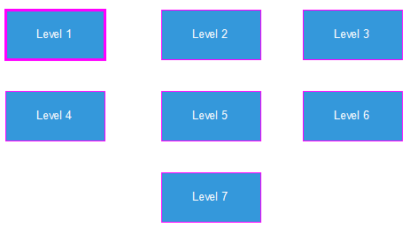
Game divided into modules

Slide 3
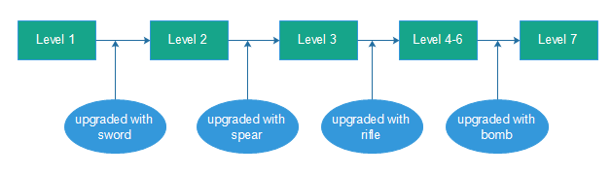
Interaction between levels

Slide 4
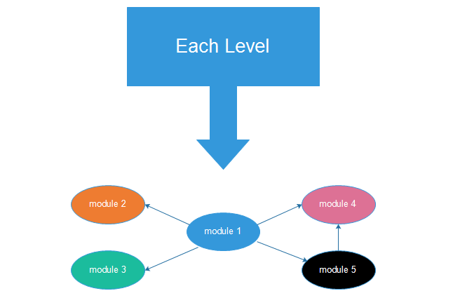
Subdivision of Levels

Slide 5
Presentation Overview
Top level Design
Level 1-3 (Team manager:- Dawit Tefera)
Level 4-5(Team manager:- Surafel Getachew)
Level 6-7(Team manager:- Nathan Mattewos)
Game development Procedures
Mockups
Introduction Video

Slide 6
Top Level Design By: Biniam Kassahun
Data Manager
The data manager is responsible for retrieving game data from the file system or some other persistent storage and for managing storage and retrieval of game state for save/load game functionality.
The simulation is the heart of the game itself. This component realizes the virtual world of the game and maintains the rules of the game.
Object System
Simulation Controller
Game Engine
Game objects represent the actors of the game world. A game object can be either static or dynamic. Static game objects do not react to external stimuli and therefore, do not interact with the world or other game objects.
The game engine is responsible for interacting with the player, through the computer hardware and operating system

Slide 7




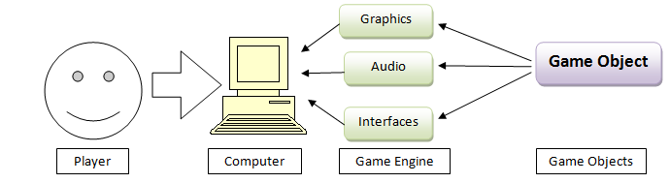
The Game Engine
Unity3D Engine offer reusable components that can be manipulated to bring a game to life. Loading, displaying, and animating models, collision detection between objects, physics, input, graphical user interfaces, and even portions of a game's artificial intelligence can all be components that make up the engine
Which Game Engine?
The primary modules in the game engine

Slide 8
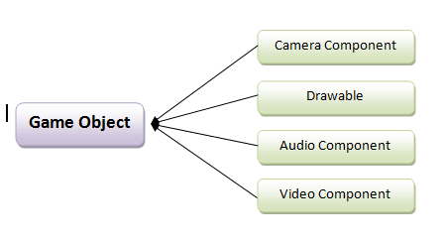
The Game objects
The object system is responsible for maintaining the state information describing all objects in the game world. This system resides in memory for real-time access to all game state information.
A camera is an object that defines a view in scene space.
Drawable components are rendered by the game engine
Audio components are concerned with special effects of audio
A camera is an object that defines a view in scene space.

Slide 9
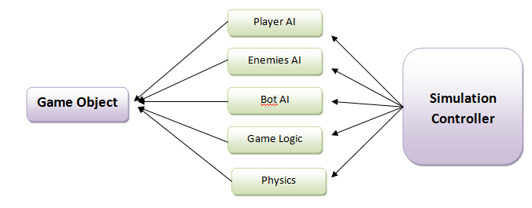
The Game Simulation
The simulation is the heart of the game itself. This component realizes the virtual world of the game and maintains the rules of the game. The simulation control module receives player input information from the game engine and passes it to The Player AI, The Enemies AI, The Bot AI module, The Game Logic or to The Physics.
.

Slide 10
Unity3D Game Engine
Unity3D Game Engine
Version Controller
Graphics Elements
Physics Components
Scripting Tools
User Interface Systems
Camera
Collider
Event System
Canvas Components
Lighting
Character Joint
Train
Time & Frame rate mng
Visual Components
Cloth
Sprite
Control Game Objects
Character Controller
Interaction Components
Constant Forces

Slide 11
LEVEL 1

Slide 12

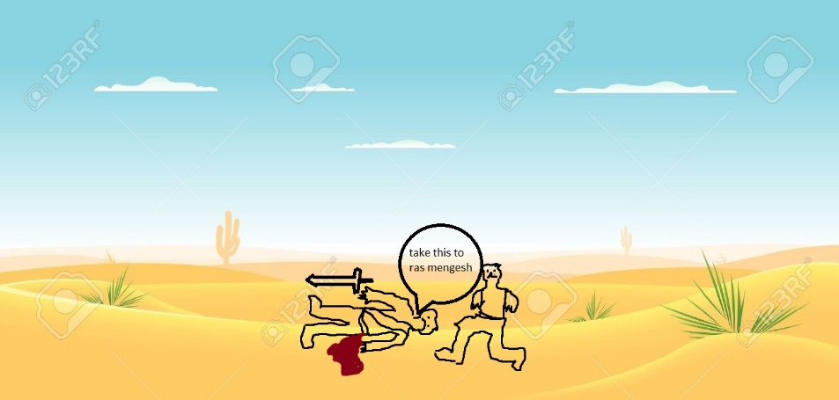
Narration video two narrations 1, letter reading 2, taking the token
Prepared by Abrham Fekade
ይድረስ ለራስ መንገሻ
ከጠላቶቻችን ጋር የደፈጣ ውጊያ መጀመሬን ሳትሰማ የቀረኽ አይመስለኝም፣ሆኖም ባላሰብኩት ወገን በመጠቃቴ ክፉኟ ተጎድቼ ነዉ ይኽን ደብዳቤ የምጽፍልክ...
ከባህታ ሃጎስ

Slide 13
Game Description
level one is aimed to express the event that happened in the place called halai between bahta and tossile though we wrote the game based on the real life event, we created the player to be fictional due to inconsistency win over our enemy.
Sequence of events
- finding the letter
(reading map)
- finding the lake (environment view )
- finding bahta
(history relevance)

Slide 14
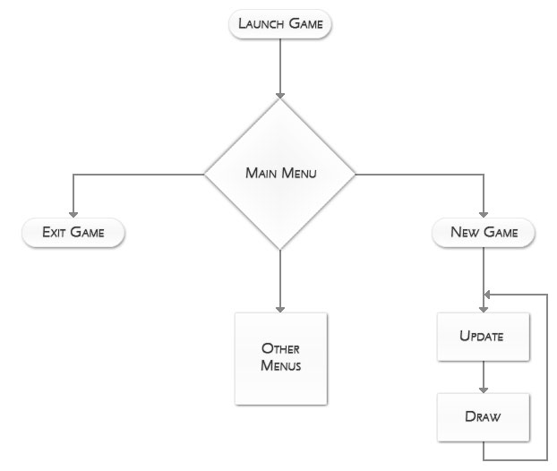
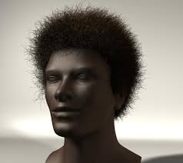
DESIGN GOAL
There are two inputs
1, design or graphic input 2, logic input

Slide 15
Game flow
Prepared by Nathan Mathewos
Start of Level 1
Am I notified?
NO
YES
Use the Map to head to Lake KURMA before health deteriorates
The game terminates
YES
Am I dead?
NO
Drink water from the lake
Approach Bahtahagos
NO
The game terminates
YES
Recieve sword from Bahtahagos
End of Level 1

Slide 16
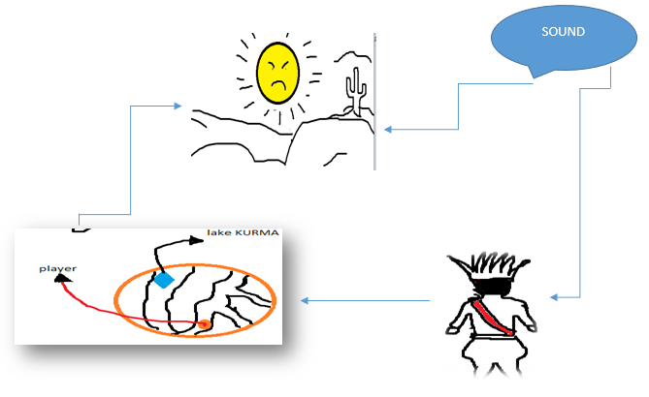
Architectural Design graphical representation

Slide 17
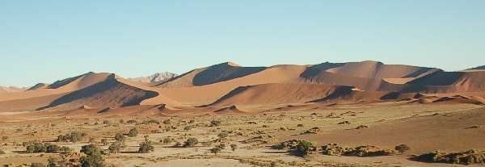
Description of architecture views
Environment: the environment will look like a desert location since it is near Dalol (the lowest level on earth).
Challenge: the challenge in this level is not a human enemy, but a challenge of getting over the environmental challenges.
Player: the player stars with a drained health condition.

Slide 18
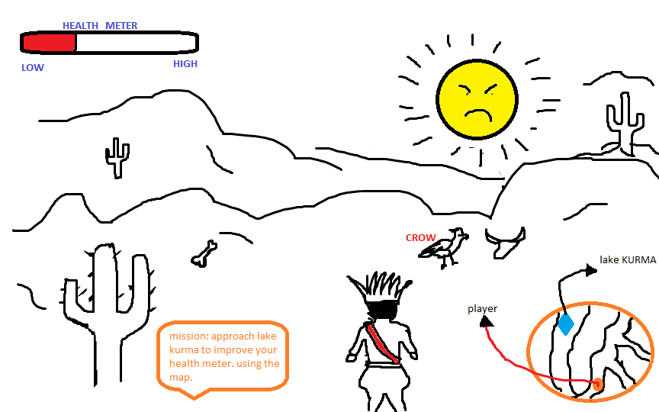
Interaction between Views
Map
Player
Environment (skybox)
Sound
GUI’s

Slide 19
Prepared by IBRAHIM ELIAS
CORE GAME PLAY
HAPPENINGS IN THIS LEVEL
Player finds a wounded soldier with a message and reads it.
Player decides to go to Halai (Bahta Hagos's location).Player knows Bahta's location from the map popping in a corner.
Player gets to water.
Health deterioration (Player's health deteriorates due to the weather).
Animations (in the beginning middle and end of the game).
Checkpoints
1. Getting message from wounded soldier.
2. Getting to the water source.
3. Finding Déjà mach Bahta Hagos.
HOW THE PLAYER PLAYS THE GAME
This is the first level of the game; in this level the player plays the game using basic controls and some interaction controls mentioned below.
Action key to perform reading. (Player finds a wounded soldier with a message and reads it.)
Movement control to navigate through the map. (Player decides to go to Halai (Bahta Hagos's location).Player knows Bahta's location from map popping in a corner.)
Action key to drink water. (Player gets to water.)
Action key to receive sword.( can also be animated)

Slide 20
PLAYER
While (1)
If action from keyboard == “w”
Player moves forward;
else If action from keyboard == “s”
Player moves backward;
else If action from keyboard == “a”
Player moves left;
else If action from keyboard == “d”
Player moves right;
else If action from keyboard == “space”
Player jumps;
else If action from keyboard == “LShift”
Player advances faster in the direction the player is facing;
If action from keyboard == “c”
Player crouch irrespective of the direction faced;
HIGH LEVEL AND DETAILED DESIGN
LOGIC FUNCTIONS
Sound
While(1)
Check player level; Play selected level background music
Check weapon at use; play sound of selected weapon used when it’s in use
If player dies
Play dying sound of starving

Slide 21
Environment
Since the in environment holds every component in these game the duty of checking the position and activating enemies is given to it.
So it becomes
Check position change in player //first move of player (for the first time only)
Activate notification
Check if notification is destroyed
If destroyed save this point as last checkpoint.
While (1) // always do this as loop
Check the distance between player and sound source
If in range activate the sound source
7. Display end of level notification
8. Terminate the level.
Challenge
while (1)
while (player is in the environment)
Degrade health status in proportion to time spent in the environment
Destroy.
Map
While (1)
Fix map to the top wright corner
Track player
Plot the player

Slide 22
LEVEL 2

Slide 23
Description By: Bethlehem Biyansa
The game on this level is based on the battle of Coatit, which was between the Italians, led by Baratieri, and Ethiopian proxies led by Tigrian warlord Ras Mengesha Yohannes in what is now present day Eritrea.Weeks after crushing Okule´-Kusai rebellion in northern Ethiopia at Halai, Italian General Oreste Baratieri turned against rebel leader Ras Mangasha of Tigre. The Italians and native askaris attacked Ras Mangasha northeast of Adowa at Coatit, where badly armed Tigreans fought a brave draw, then withdrew.

Slide 24
GAME MECHANICS
The player in this stage is supposed to save RasMengesha and help him fled from senafe.
Will get to RasMengesha’s position with the help of map.
Will come across low abilities soldiers.
Saves Rasmengesha.
Along the way will come across 5 low abilities soldiers which will be met individually.
The map will lead them to RasWelle and RasMekonen.
The player will be awarded with spear.

Slide 25
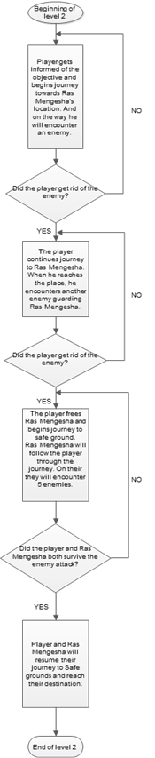
Game Flow Diagram

Slide 26
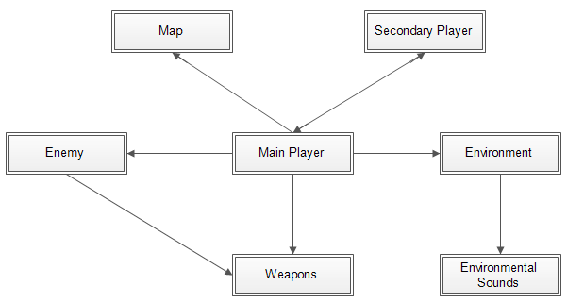
Architectural Design of Level 2 By: Dawit Tefera
Graphical Representation

Slide 27
Architectural Description
Main player: is the main character in the game that is controlled by the user.
Enemy: are the opposing soldiers (Italian soldiers) in the game. They are activated only when the player is in a certain range from them. Then they come on to the player and start attacking.
Weapons: are objects like swords, spears, guns etc…
Environment: Are the locations and its surrounding for the level 2 action takes place. The location changes from scene to scene.
Environmental Sounds: Is the different background sounds heard during game play. The different sounds are played in accordance of the player location and actions.
The secondary player: the secondary player is the player that is designed to go where ever the main player goes. For this level Ras Mengesha is the secondary player.
Map: provides information to the user where the players location is.

Slide 28
Architectural Components Interaction of Level 2
The main Player: - Interacts with all other components as it will activate others to execute their respective tasks
Enemy: Activated by the main player, he/she will approach and start attacking. This component also has the ability to pick up and carry a weapon. So it will interact with the weapon component.
Weapons: are the objects in the game play. These objects do not act by themselves. If they are dropped they are inactive unless the player or a soldier picks them up.
Environment: the environment is continuously updated to ensure the user feels that the player is moving to the desired locations.
Environmental Sounds: are called by the environmental view. As discussed previously when the player moves around and the environment is continuously updated, the sound s also updates to simulate the environment more accurately.
The secondary player: this secondary player is first awakened when the main player finds the place where he is captive and frees him. Then he will follow the main player through all the battles to reach safety grounds. Here unless Ras Mengesha reaches safe place, the player will not advance to the next level. So this component will interact with the main player component.
Map: this object is interfaced with the main player to get the current location of the player and continuously updates throughout the game play.

Slide 29
PSEUDO CODE By: Hemela Belachew
Most of the design features on this level are similar to level 1, the additional feature is Ras Mengesha’s role and activity
Ras Mengesha’s role in pseudo code
WHILE (1)
TRACK PLAYER POSTION
FOLLW THE PLAYER
ATTACK ENEMIES IN RANGE

Slide 30
LEVEL 3
BATTLE OF AMBA ALAGI
DESCRIPTION AND
CORE GAME PLAY

Slide 31
BRIEF HISTORY
The game on this level is based on the battle of Amba Alagi, which was fought between the Italian General Baratieri and Ethiopia's Emperor Menelik during the First Italo-Ethiopian War. This battle led to the annihilation of the Italians and the death of major Toselli.

Slide 32
OBJECTIVE
With accountability of the history of battle of Halai and battle of Amba Alagi in mind, the player who progressed from the second level with spear will start his/her journey with the aim of getting rid of Major Toselli with lowly able soldiers kept as a challenge.

Slide 33
DESIGN GOALS
Will be able to achieve a reward, riffle.
Experience a storyline which is accountable to the actual history.
The player will be able to use his/her sword and spear.
Create landscape and other features according to the true events.

Slide 34
CORE GAME PLAY
In order to pass this level the player has to use the following:
Action key to swing sword won on level 1.
Action key to throw spear won on level 2.
Movement control to navigate through the map.
Action key to take rifle from Major Toselli.

Slide 35
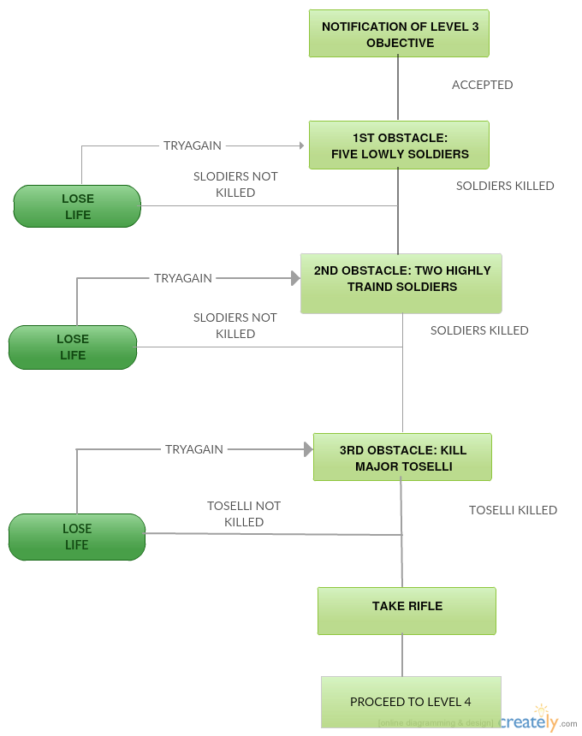
GAME FLOW DIAGRAM

Slide 36
GAME PHYSICS AND STATSTICS
Crouching: to pass through barriers
Sprint: basic action of sprinting forward fast
Jogging: basic action of jogging around arena
Switch weapon: to switch b/n sword and spear
Fire: to swing sword or throw spear

Slide 37
Architectural Design
By: Fraol Wondimu

Slide 38
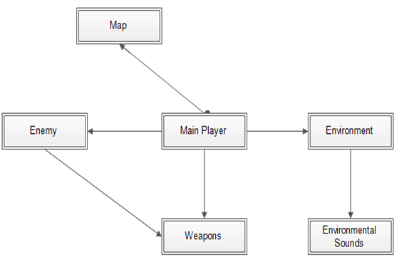
Graphical Representation

Slide 39
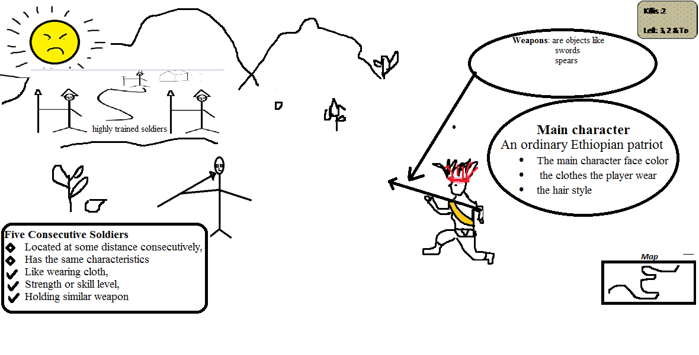
Description of Architecture Views

Slide 40
Interaction between views
There is an interaction between :
The main player
Enemy
Weapon
Environment
Environmental Sounds
Map

Slide 41
Detailed design of level 3
By: Betsegaw g/yohannes

Slide 42
The detailed design of this game contains pseudocode for the player, Enemies, Environment, sound and map.
Pseudocode for Player
The pseudocode for player contains 3 main methods(functions)
when player attacks
Player attacking ()
If (attack_Key_Pressed)
If (Selected_Weapon is ­­sword)
Aim at the enemy;
SwingSword;
Else if (Selected_Weapon is spear)
Aim at the enemy;
Throwspear()
End if // weapon
End if // attack key
When the player is getting attacked
if (player is attacked by one of the 2 armed soldiers or toselli)
while (health status is not empty)
decrease health status twice
End if
if (health status is empty)
terminate level;
End if
Checkpoints
checkpoints ()
if (player destroys all the lowly able soldiers)
save the first checkpoint
if (the player destroys the 2 armed soldiers)
save the second checkpoint
End if

Slide 43
Pseudocode for Environment
The main script in the environment is to Check the position of the player and activate enemies.
Check positon change in player //first move of player (for the first time only)
Activate notification
Check if notification is destroyed
If (destroyed)
save this point as last checkpoint.
While (1) // always do this as loop
Check the distance between enemies’ and the player
If (in range )
activate enemies
Check the distance between player and sound source
If (in range)
activate the sound source
Check the number of remaining enemies
if (none)
Display end of level notification
Terminate the level.
Pseudocode for Enemy
while (1) //always
Check player position
Enter in the range // by approaching
If in long range
Fire to the player // to the player position
Else If in short range
Perform combat action
If (get attacked)
While (health bar is not empty)
Degrade health status
if (health bar is empty)
destroy

Slide 44
LEVEL 4

Slide 45
Level 4 : Game description By: Surafel Getachew
Based on the battle between Albertone’s brigade and Ethiopians mountain artillery
Albertone was captured not killed!!
Enemies come at him in pairs or three
Has to kill 18 of them first
2 more come at him with Albertone, kill the two soldiers and capture Albertone
Albertone shouldn’t be injured
Level passed!!!

Slide 46
Design Goal
Introduce Albertone’s brigade and Ethiopian’s with their mountain artillery
Give the player a reward for his progress
Try not to lose the history of the game(Like not killing Albertone)
Develop a landscape that is somehow similar to the place that really happened at that time.

Slide 47
GAME FLOW DIAGRAM
Beginning of Level 4
Receive weapons and attack enemy when they are in range
NO
Checkpoint
YES
Kill 18 soldiers?
NO
Capture Albertone and Kill his two soldiers
YES
Is Albertone alive?
NO
YES
End of Level 4

Slide 48
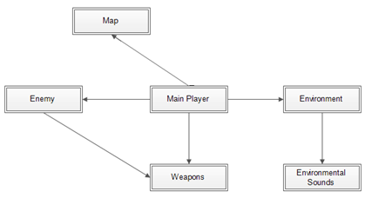
Architectural Design By: Selam Habtom
Graphical Representation

Slide 49
Main player: is the main character in the game that is controlled by the user in this level the player will find themselves set up on a mountain with a mountain artillery. Enemy: are the opposing soldiers (Italian soldiers) in the game. They are activated only when the player is in a certain range from them. Then they come on to the player and start attacking. The enemy's will be the brigade that is controlled by Albertone's.

Slide 50
Environment: is the location and its surrounding for the level 4 action takes place. The location changes from scene to scene.
There will be mountain in,which the Ethiopian's (Ras Alula's position)
one mountain for KidaneMeret,then, Italian brigades (Albertone's askari brigade) was the first to encounter the onrush of Ethiopians at 6:00, near KidaneMeret, where the Ethiopians had managed to set up their mountain artillery.
The fight locations with the soldiers encountered: These places are fictional. (The fights did occur only that the places might not be accurate),The overall terrain where the player operates
Environmental Sounds:- Is the different background sounds heard during game play. The different sounds are played in accordance of the player location and actions. Map: provides information to the user where the players location is.

Slide 51
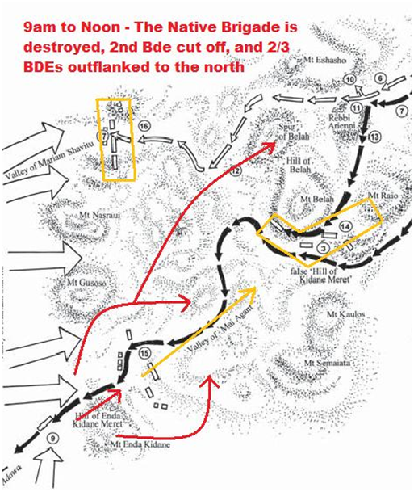
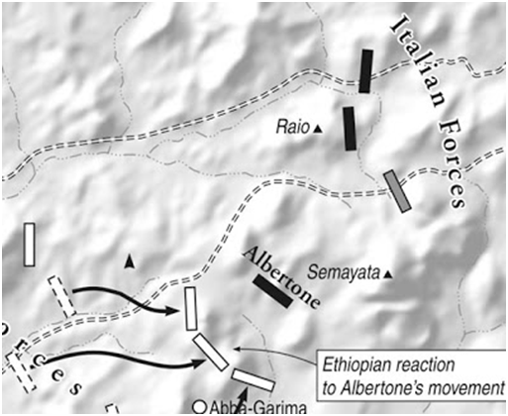
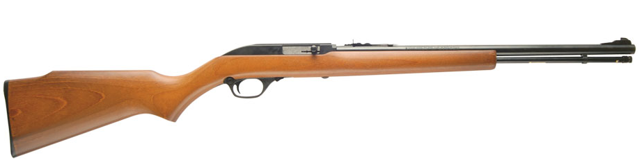
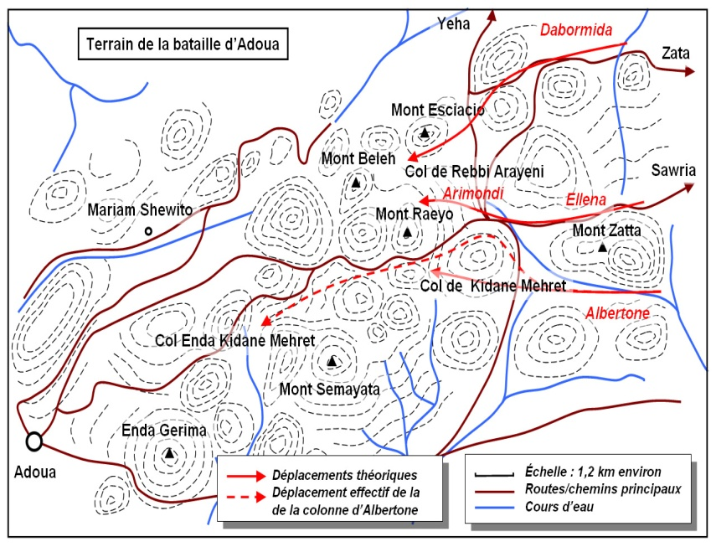
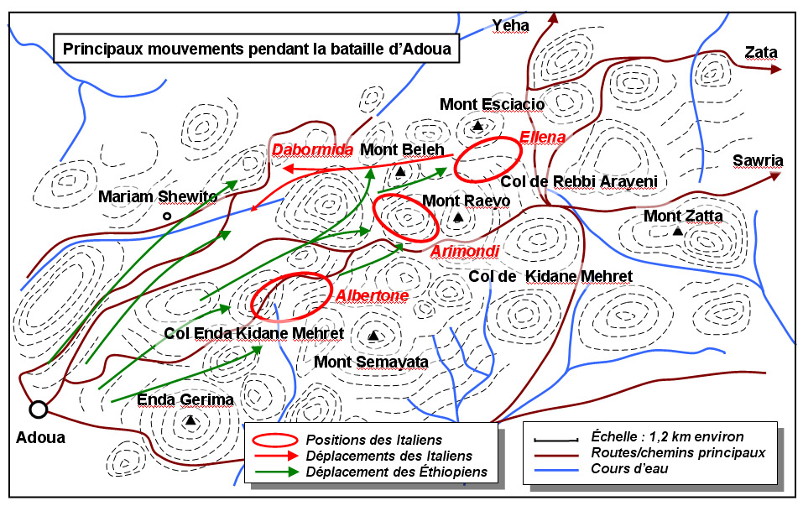

Slide 52
HIGH LEVEL AND DETAILED DESIGN By: Frezer Tadese
Environment
Check positon change in player //first move of player (for the first time only)
Activate notification
Check if notification is destroyed
If destroyed save this point as last checkpoint.
While (1) // always do this as loop
Check the distance between enemies’ and the player
If in range activate enemies
Check the distance between player and sound source
If in range activate the sound source
Check the number of remaining enemies
If none
Display end of level notification
Terminate the level

Slide 53
Enemies
while (1)
run towards the player position
If in long range
Fire to the player // to the player position
ElseIf in short range
Perform combat action
If fired to self
Degrade health status
If health status reaches zero
die
Destroy.

Slide 54
Albertone
While(1)
run towards the player position
If in a reasonable range
Fire to the player
If fired to self
Degrade health status
If heath status reaches zero
die(Game over)
If(all the other enemies are dead && the player aims on self)
raise hand up(level passed)

Slide 55


Level 5
ውጊያ ፭
Prepared by፡ Ibrahim Elias
Samrawit Demeke
Tirusew Zerihun

Slide 56
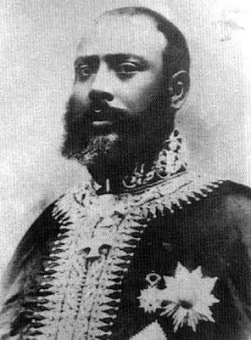
Game description
The game in this level is based on the fight between the Arimondi Birgade and the Ethiopian mountain artillery soldiers that are later joined by the 25,000 shewans from Minilik.

Slide 57
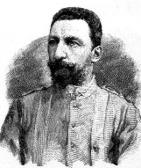
Design goals
Introduce Arimondi and the Shewan
forces of Minilik.
Serve as a continuity to Level 4.
Develop an achievement system that
rewards the player with more bullets.
Develop a level that keeps its
accountability to the actual history
while still providing entertainment.
Have art and design that is in sync with
the previous level as they contain the
same landscape settings.

Slide 58
Narration video
The narration will have this written content:
የአልቤርቶን ወታደሮች ሲሸሹ የተቀላቀሉት የአሪሞንዲን ጦር ነበር፡፡ የአሪሞንዲ ጦር ኢትዮጲያውያኑን ለሁለት ሰዓታት ያህል ሊከላከል ቢችልም ከምንሊክ የሚመጣው 25,000 ጦር ድምጥማጡን ያጠፋዋል፡፡ የምንሊክ ጦር እስኪደርስ ድረስ የአሪሞንዲን ጦር በመዋጋት በሕይወት ቆይ፡፡
The Amharic narration above will be shown at the beginning of the level. The objective is already mentioned in the introductory narration and the game begins right afterwards.,

Slide 59
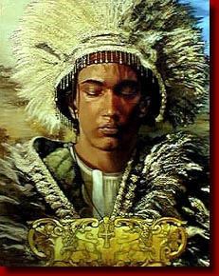
Narration video (continued)
The order of pictures and narration.
1. የአልቤርቶን ወታደሮች ሲሸሹ የተቀላቀሉት የአሪሞንዲን ጦር ነበር፡፡
Pictures of Arimondi and his soldiers will be shown.
2. የአሪሞንዲ ጦር ኢትዮጲያውያኑን ለሁለት ሰዓታት ያህል ሊከላከል ቢችልም ከምንሊክ የሚመጣው 25,000 ጦር ድምጥማጡን ያጠፋዋል፡፡
Minilik along Shewan soldiers are shown.
3. የምንሊክ ጦር እስኪደርስ ድረስ የአሪሞንዲን ጦር በመዋጋት በሕይወት ቆይ፡፡
The player character is shown holding his weapon with a fierce look on his face to entice our player to a furious state of war.

Slide 60
start
Am I notified?
NO
Yes
Follow Albertone’s soldiers
NO
Keep Following
Do I see an enemy?
Yes
Attack
Am I dead?
Yes
Finish
Any enemy remained?
NO
Yes
Follow and Attack

Slide 61
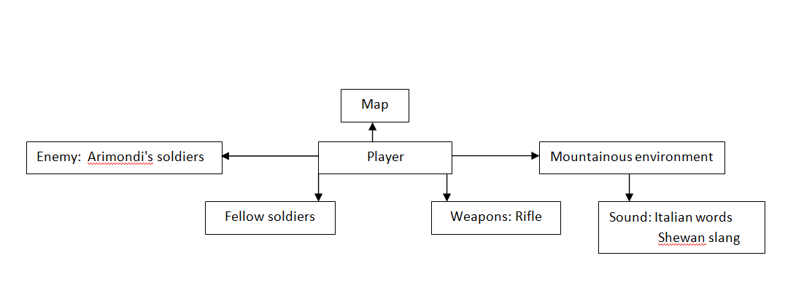
Architectural design

Slide 62
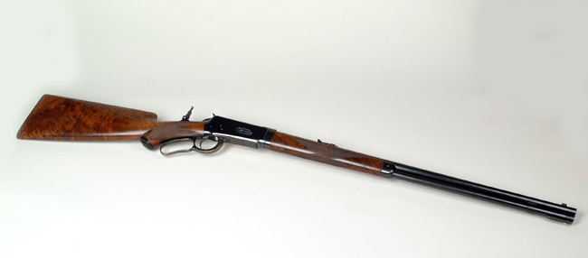
Player weapon on Level 5

Slide 63
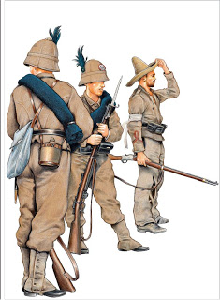
Enemy
Design of their look
-Grey colored uniforms
-Blue sleeping mats
-A bell-shaped hat with a feather
-A brown colored wooden rifle

Slide 64
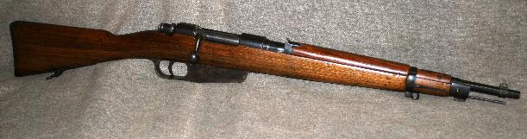
Enemy Weapons
Fig: Carcano Model91 rifle

Slide 65
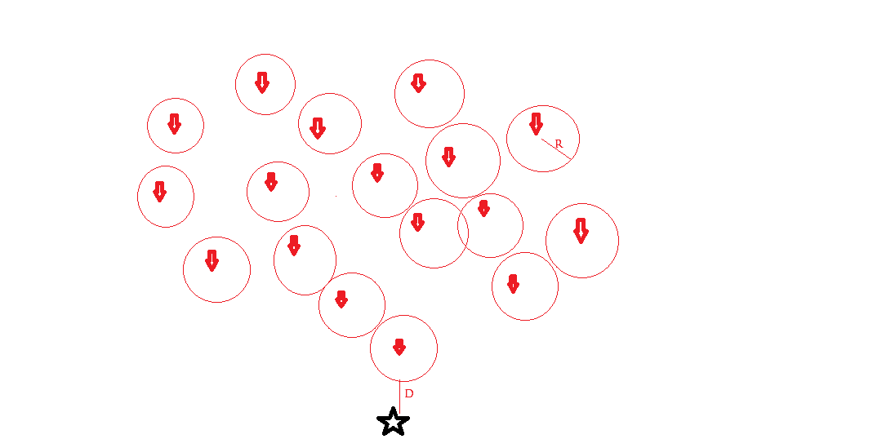
Representation of the soldiers
Player
Enemy soldiers
When R=D, soldiers get activated.
When looking at an enemy, yell “Zeraf”.
When shooting, activate rifle sound.

Slide 66
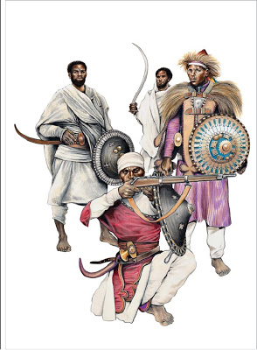
Fellow warriors
They will be 40 in number.
They are capable of everything the player can do. They will run, slow down, jump, shoot their rifle and duck to defend themselves from the coming on fire.
The sounds they make are:
Shilela
a "watch out" warning to their friends.

Slide 67
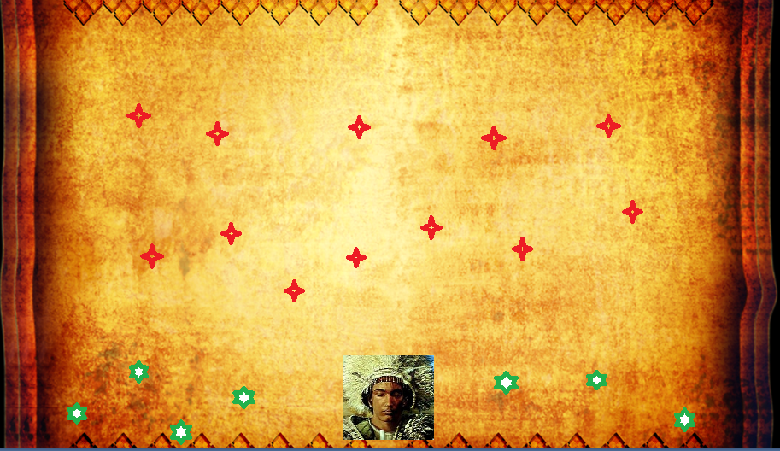
Map for level 5

Slide 68
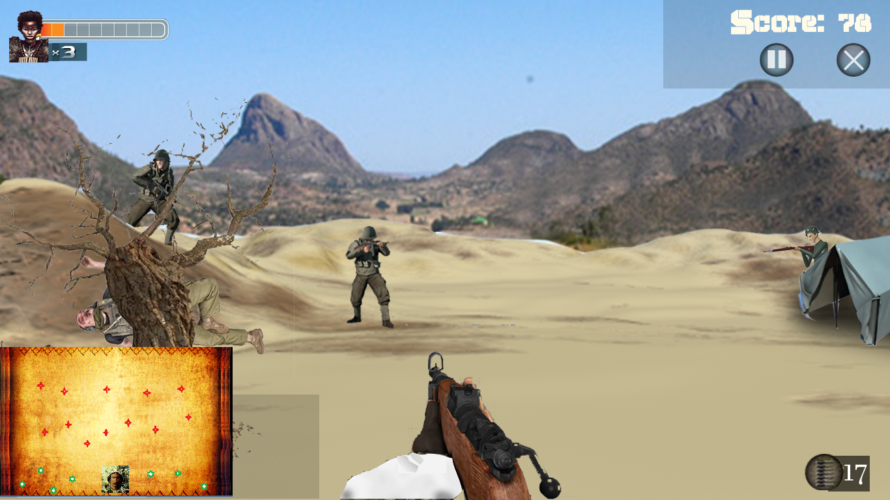
Position of map on screen

Slide 69
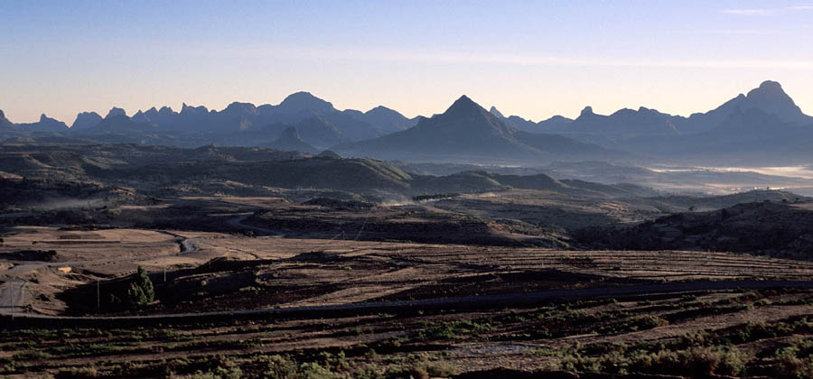
Environment

Slide 70
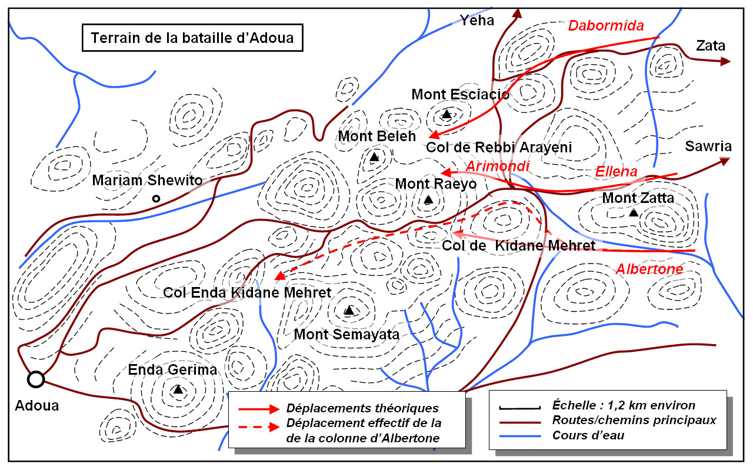
Battle map: Italian Advance

Slide 71
Battle map: Ethiopian Movements

Slide 72
Detail design
By:- Ibrahim Elias

Slide 73
CORE GAME PLAY
HOW THE PLAYER PLAYS THE GAME
This is the fifth level of the game; in this level the player plays the game using various game play controls and interaction controls mentioned below
Movement control to move around while attacking or defending.
Sprinting control if a player needs to run.
Attacking and defending whenever player is near enemy.
Action key to switch between weapons if a player gets another weapon (if a player killed an enemy and acquire the weapon).
Jump using jumping control if a player needs to jump while attacking and defending.
Use a defending shield to protect from an enemy attack.
Crouch using crouching control if a player needs to crouch while attacking and defending.
HAPPENINGS IN THIS LEVEL
Player gets notified of objective for this specific level.
Player fights with Arimondi's soldiers.
Positional and camera change following the fleeing of Albertone soldiers.
Player kills all the soldiers coming their way.
The player needs to stay alive until Menelik released his reserve of 25,000 Shewans and swamped the Italian defenders.
A war against Arimondi's brigade vs. the Shewans led by Minilik.

Slide 74
HIGH LEVEL AND DETAILED DESIGN: LOGIC FUNCTIONS
Player
If action from keyboard == “LClick”
Player attacks nearby enemy;
If weapon selected is shoot able
Shoot the weapon in a direction a player is facing
Else if swing the weapon selected in a direction player is facing.
Else If action from keyboard == “ Capslock && LClick”
Zoom in at the direction player is facing and fire;
If weapon selected is shoot able
Shoot the weapon in a direction a player is facing
Else //weapon is not shoot able
weapon cannot zoom
If action from keyboard == “ x”
Player throws spear if the selected weapon is spear;
Else selected weapon cannot be thrown; select throw able weapon
If action from keyboard == “r”
Player bocks an attack by an enemy;
Environment
Check position change in player //first move of player (for the first //time only)
Activate notification
Check if notification is destroyed
If destroyed save this point as last checkpoint.
While (1) // always do this as loop
Check the distance between enemies’ and the player
If in range activate enemies
7. Check the distance between player and sound source
If in range activate the sound source
8. Check the number of remaining enemies
If none
Display end of level notification
Terminate the level.

Slide 75
Enemies
while (1)
check player position
Approach player position
If in long range
Fire to the player // to the player position
Else If in short range
Perform combat action
If fired to self
Degrade health status
Destroy.
Map
While (1)
Fix map to the top wright corner
Track player
Plot the player
Track the enemies
Plot enemies
Sound
While(1)
Check player level; Play selected level background music
Check weapon at use; play sound of selected weapon used when it’s in use
While(player is being hit || player is hitting)
Play “hit” sound;
5. If player dies && player health is empty
Play dying sound
Else do nothing
Enemy Runners
While(1)
Check game beginning
Run away from player
If hit while running life decreases
If life runs empty runner will die
If runner reaches Arimondi's soldiers, join and fight with the fighters

Slide 76
LEVEL 6 DABORIMIDA VS THE OROMO CAVLARY By: Kilet Meshesha
History of the battel
At the time of the battle, Dabormida's Italian brigade had moved to support Albertone but was unable to reach him in time.
Menelik became informed of the Dabormida’s position.
Menelik ordered Ras Mikael and the entire left wing of 20,000 warriors supported by 8000 cavalry to move on and destroy it before it escape.
Sensing the enemy was to collapse, Ras Mikael ordered 8000 oromo cavalry to charge.
So the Ethiopian soldiers slash down the Italian’s and herd them into defenseless pocket.

Slide 77
Story line of the level
It has three flows
FLOW 1
The player will get notified on the objective then the player will find himself in front of daborimida’s army. The player will start engaging in the battel .if the player kills 30 soldiers and heavily wound daborimida ,the player will get the privilege of proceeding to the next level.
FLOW2
The player will get notified of the objective then the player finds himself in front of Daborimida’s army. The player will start engaging in the battel but fail to kill 30 soldiers. So the player will get setbacks to the beginning of the level.
FLOW3
The player will get notified of the objective then the player finds himself in front of Dabormida’s army. The player will start engaging in the battel and kill 30 soldiers but fail to wound Daborimida. As a result the player will get set back to the previous check point that is achieved after killing 30 soldiers.

Slide 78
Flow chart of level 6

Slide 79
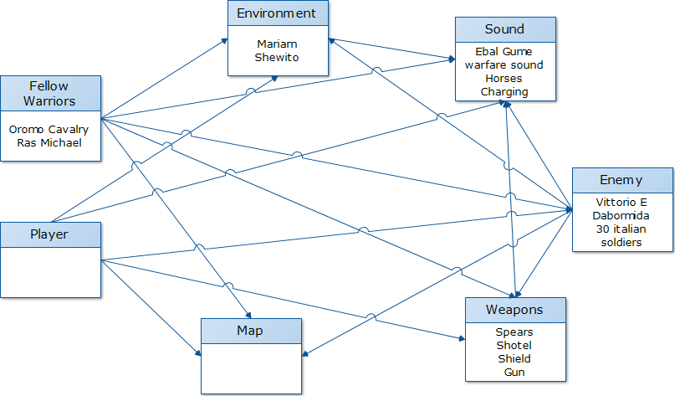
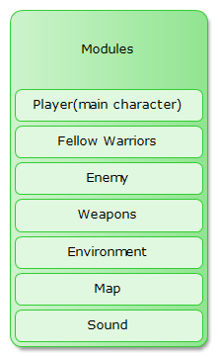
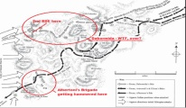
Graphical representation of architectural design By: Sura Dereje

Slide 80
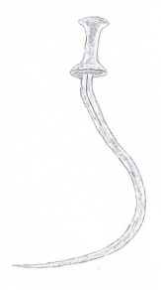
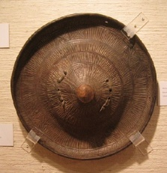
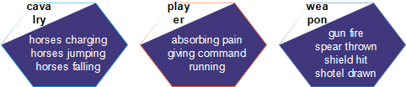
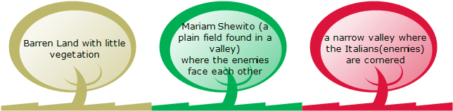
Description of Architectural views
1. Weapons
2. Sound
3. Environment

Slide 81
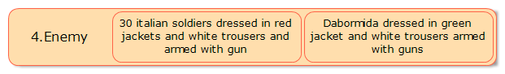
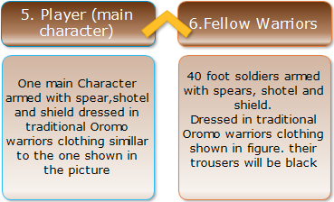
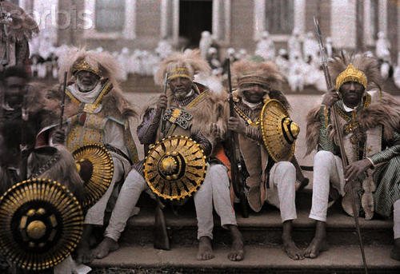
Description of Architectural views

Slide 82
Description of Architectural views Map

Slide 83
Detail Design By: Efrem Desalew
This level is single player battle game and it will have two check points. The player will reach the first check point after killing 30 Italian soldiers and the player will reach the second check point when he or she spot at Dabormida and injure him.
Main Points of the Detail Design
1.Health Points
Health Points (HPs) will be used to judge whether the player or enemies died. There will be two Heal-Points bars to be indicated on the game window. One will be placed at top-left of the game window and will be used to display health points of the enemies. The other one will be placed at the bottom-left of the game window and will be used to display the health points of the player.

Slide 84
2.Heal Boxes
Heal-boxes are the game objects which will be distributed on the terrain. Their function is to increase the health points of the player when the player finds and touches them.
3.Damage Calculation System
The damage calculation system is used to control the HPs of the player and enemies. Health Points are finite value used to determine how much damage a character can withstand. When a character is attacked, the total damage dealt (which is also represented by a point value) is subtracted from its current HPs.
4.The Interaction between 30 enemy soldiers
The location 30 enemy soldiers and their leader Dabromida will be governed by clearly defined rules.
Rule1. There will be pre-defined distance gap between these 30 enemy soldiers.
Rule2. They will be activated when the player is in a certain range from them.
Rule3. Maximum of 3 closer enemy soldiers can attack the player at the same time.
Rule4. They will become died if they got one hit from the player only their leader Dabromida can withstand up to five hits until he become heavily wounded.

Slide 85
Void soundWeapon() {
If (shoot_key_pressed&&typeOfWeapon == spear)
Play sound of spear being thrown;
Else If (shoot_key_pressed&&typeOFWeapon==sword)
Play sound of sword being swing;
Else If (shoot_key_pressed&&typeOfWeapon==shot gun)
Play sound of shoot gun;
Else
Do nothing;
}
Void soundOfHit () {
If (got hit)
Play sound hit;
Else
Do nothing;
}
Void soundOfDying () {
If (HPs<=0)
Play sound of dying;
Else
Do nothing;
}

Slide 86
6.Basic Player Actions
Void playerRun(){
If (Move_Key_Pressed&&Run_Key_pressed){
1. Move forward in the current direction
2. Continuously increase the player velocity in the current direction}}
Void playerWalk(){
If(Move_Key_Pressed){
If (Move_Key_pressed ==Move_Key_Left){
1. Change the player direction to left
2. Move the player with constant velocity to the left}
Else If (Move_Key_pressed ==Move_Key_Right){
1. Change the player direction to Right
2. Move the player with constant velocity to the right}
Else If (Move_Key_pressed ==Move_Key_UP){
1. Change the player direction to north
2. Move the player with constant velocity to the north}
Else {
1. Change the player direction to south
2. Move the player with constant velocity to the south}}}

Slide 87
Void playerStandStill(){
If(!Move_key_pressed){
1. Maintain current position}}
Void playerJump(){
If(Jump_Key_Pressed){
Change the player position in the z direction
Continuously increase the player velocity in the z-direction}}
Void playerShoot(){
If (shoot_Key_Pressed){
If (Selected_Weapon==­­sword){
1. Aim at the enemy
2. playerSwingSword();}
Else if (Selected_Weapon==spear){
1. Aim at the enemy
2. playerThroughSpear();}
Else if (Selected_Weapon==shotGun){
Aim at the enemy
playerShotGun();
}}}

Slide 88
LEVEL-7 War of the Mount Belah
Game Mechanics (Graphics Perspective)
Bereket G/mariam

Slide 89
Overview
Environment
place of war :around Mount “Belah”
Landscape: mountain
On the day of the war : there was a rain
Tents on both side
Overview
King Teklehaimanot of Gojjam vs. Baratarie of Italy
The last level of the battle of Adwa
The Baratieri forces are weakned and fewer in number

Slide 90
Design challenge
The level should be hard to play than other levels vs. few soldiers left on the Italian side
Goal: preserve both possibly
Tradeoff
The historical part of the game will be preserved and fictional stories will be added .
There will be some mind games to enhance the complexity cheating
Unlocking, stealing bombs, contaminating the Italian soldiers etc.

Slide 91
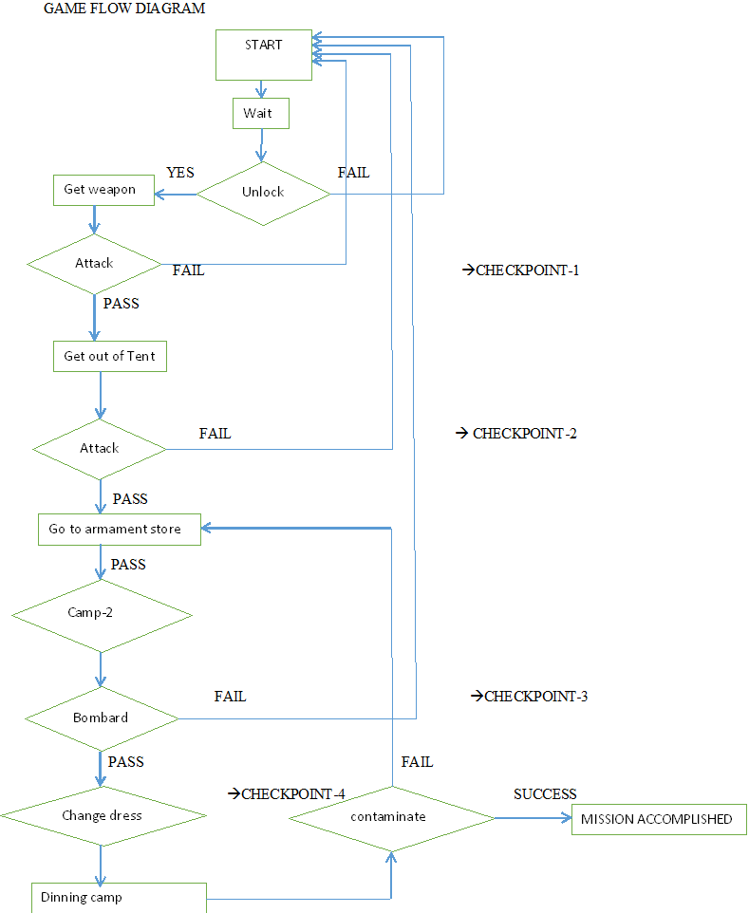
Checkpoints
There will be four checkpoints
CHEKPOINT-1
Unlocking, killing the guards, armed with weapon
CHEKPOINT-2
Killing the 5 armed soldiers of Italy on the way to the second camp.
CHEKPOINT-3
Get into the armament tent and steal bomb
Destroy the second camp and the collection of military cars
CHECKPOINT-4
Changing dress(dress exactly like the Italian soldier)
Taking toxic object
Get into the kitchen and contaminate the dishes to kill around 30 soldiers at once

Slide 92
Architecture Views By: Sentayehu
What are the perspectives to describe the architectural views of the level? The answer to that is: Historical back ground
1) Historical back ground
A) In fighting perspective
The battle of Adwa can be called a meeting engagement, which is a type of offensive combat. It was a clash of troops of the two sides advancing toward each other. From the outset, both sides attempted to carry out the assigned missions by means of a strategic offensive.
The strategic design undertaken by Menelik and his army lieutenants was focused on being engaged in conventional war a fight of army against army in the open field.
Though this strategy contributed to the heavy loss of human resources on both sides.

Slide 93
B) In land mark perspective
The time the war of Adwa came to an end the last two brigades under a Baratieri command were outflanked and destroyed At Mount Belah, by Ethiopian force.
C) Time/sun light perspective
Italians plan to attack at night time because of not to be detected by Ethiopians troops
The last battle of adwa At Mt. Belah, come to an end At noon.
D) Weather perspective
The main struggle for Italian troops was the series of circled mountains and the heavy rain.
E) Aftermaths perspective
the victors of Battle of Adwa killed 289 Italian officers, 2,918 soldiers and about 2,000 Askari, while 470 Italians and 958 Askari were wounded. Some 700 Italians and 1,800 Askari fell into the hands of the Ethiopian troops.

Slide 94
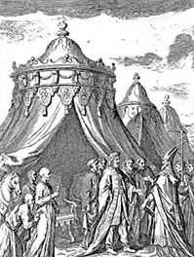
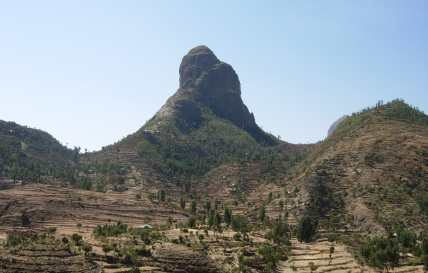
Architecture Views of the level
It’s easy to describe and design the architecture view of the level from the above historical back ground and war perspectives.
A) Environment:
Place of the Event.
Royal & dinner Tents.
Open filed.
Circled by Mount Belah and other mountains.

Slide 95
Time/light and weather
After Midnight up to noon, (moon light, sun rising and sun overhead)
Rainy weather at the morning.
Sounds
Few Additional sounds from other levels.
Random voice of a man in pain (wounded).
Random voice of a desperate Italians.
Random voice of a victory of Ethiopian.

Slide 96
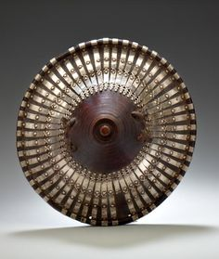




B) Game play
Weapons:
Both traditional and modern weapone (at 19 century) which are token from Italians.
Poison
A piece of iron which is sharp.
Traditional weapons as other levels.
Swords, spear and shield old gun (one shot one reload ”ቁመህ ተብቀኝ”)
Modern weapons.
Classic guns one shoot and preload (ማቀባበል)

Slide 97
Game Logic By: Dawit Abrham

Slide 98
Game Objects
Main Character
a) Weapon Choice
b) Sneak Attack
c) Spear Throw
d) Spear Retrieval
e) Sword Attack
f) Firearm Attack
g) Movement
b) Sneak Attack
The player can sneak up behind an enemy and perform a special kind of attack to kill the enemy soldier silently.
Pseudo Code
While the player is within one meter of the enemy soldier
If the player is not spotted and if the player is behind the soldier
Display a sneak attack button (E)
If the player presses this sneak attack button (E)
Perform Sneak Attack (Call an animation of the sneak attack being performed)

Slide 99
Game Objects
Enemy Soldiers
a) Patrol
b) Spotting The Character
c) Attack only two at a time
d) Hearing Sounds
e) Looking at dead enemy soldiers
f) Alarmed Soldier State
g) Level of difficulty of attack
Looking at dead enemy soldiers
When the enemy sees a dead soldier, he will panic and alarm nearby soldiers
Pseudo Code
Get the line of field of the soldier
If a dead soldier lies within the field of sight
Play a panic animation
Alarm nearby Soldiers

Slide 100
Game Objects
2) Main Character State
The main character has the following states he can be in
Neutral:
When the player is not fighting and sneaking around
Fighting Mode:
When the player is engaged in a fight with a soldier
1) Enemy Solder States
The soldiers can be in one of the 4 states.
Neutral:
When the soldier is patrolling the surrounding and has not spotted the character yet.
Alarmed:
If the soldier hears a sound and is spooked
Spotted Character:
If the soldier spots the character
Fighting Mode:
If the soldier is engaged in a fight with the character.

Slide 101
Game development procedures
BY – Robel Hayelom

Slide 102
How does the game development progress?
What are the milestones in the implementation process?
What is the most efficient team organization that will maximize productivity?
Steps in the development process?

Slide 103
Scene (Environment) setup
Create environment
Terrain
Environment elements
Trees
Rocks
Grass
Minimum graphics elements
Natively in unity

Slide 104
Character creation and controller setup
Game characters
Main player character
Enemy characters
Major figures in the battle
Blender – Mesh design
Controller scripts
Animation
Sound

Slide 105
Weapon creation and implementation
Weapons
Sword
Spear
Shot guns
Blender – Mesh
Unity – controller scripts
Action
sound

Slide 106
Enemy bots setup
Challenge patterns
attacking
Hiding
Packs
Controller scripts
Patterns
Sound

Slide 107
Player tools
Map
Location and direction of motion
Health bar
Hits taken
Hint (objective) display
Game mission and hits
Aim
Shooting ( striking) target

Slide 108
Game manager and in game GUI
In level controls
Pause /resume
Mute / unmute
Game loop
Complete – progress
Fail - restart

Slide 109
Animations and narrations
Animations and motion graphics
Story
Game missions
Coherence between the levels

Slide 110
Special effects and other objects
Minor game objects
Vary in kind and purpose
Very important
Includes
Heal boxes
Rewards
…

Slide 111
General game manager
Manages the game in application level
Manages levels
Start /resume /load game
Quit game
Marinating and managing global game variables
Game wide configurations
Key config
…

Slide 112

summary

Slide 113
Mock ups
We have created mock ups that will be used
through out the game.
Player
Enemy
Environment
Fighting Materials

Slide 114

Player

Slide 115




Enemy

Slide 116

Environment

Slide 117



Weapons

Slide 118

Final Screenshot

Slide 119

Main Menu

Slide 120

Reading Messages

